Slide 1

Robot Framework

Slide 2
Agenda
Creation of Test Suites
Creation of testcases
Testcase syntax
Getting Started with Robot Framework
Web UI automation
Database testing
API testing
Integration to Jenkins

Slide 3
Robot Framework
Robot framework is a generic test automation framework
It utilizes the keyword driven testing approach
Provides test libraries implemented either in python or java
No much programming needed

Slide 4
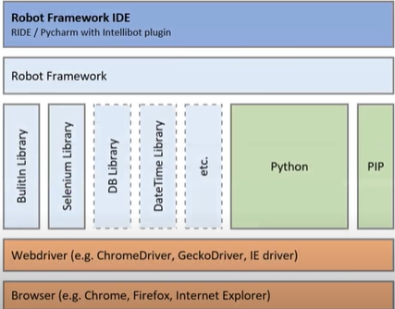
Robot Framework Architecture

Slide 5
Robot Framework Advantages
Easy integration with other tools
Detailed reporting
Wide range of test libraries
Easy to install and use, even for newcomers
Supports behavior-driven, keyword-driven, and data-driven styles of building test cases

Slide 6
Robot Framework –Where to apply
Software testing
Robot Framework is widely used to automate software testing, allowing development teams to conduct effective, rapid, and repeatable tests.
API testing
API tests can also be automated with Robot Framework, simplifying the verification of RESTful or SOAP API behavior.
User interface testing
Acceptance tests for web applications can be performed using Robot Framework, automating these processes and simulating real user interactions.
Business processes
The tool can also be used to automate repetitive business processes, such as data entry, order processing, and customer service.
Administrative tasks
Robot Framework can automate various administrative tasks, including email sending, report generation, and file management.

Slide 7
Robot Framework Set up
Install Python
Install Pycharm IDE
Install selenium
Install robot framework
Install robot framework selenium library
Install data library
Install api library

Slide 8
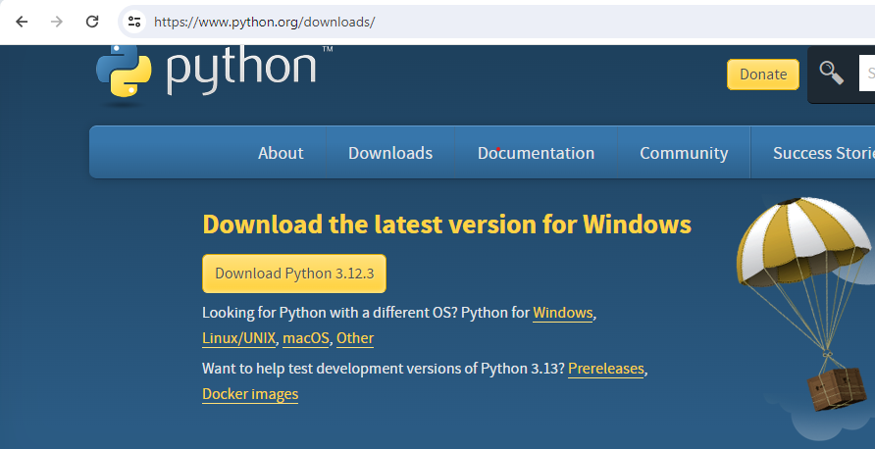
Installation of Python

Slide 9
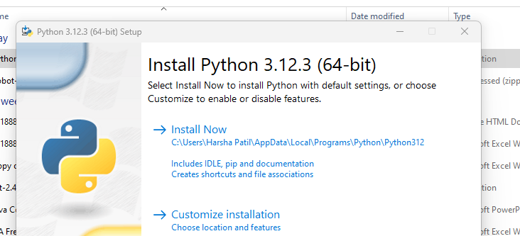
Installation of Python

Slide 10
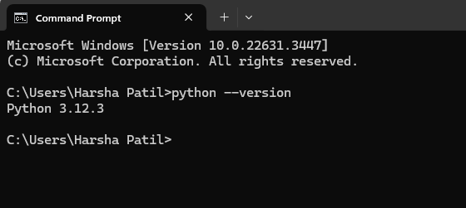
Installation of Python

Slide 11
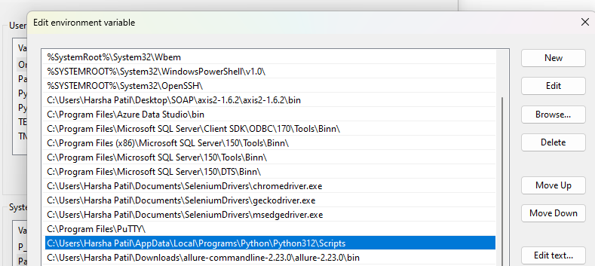
Installation of Python

Slide 12
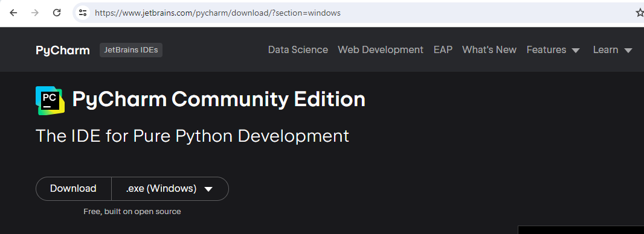
Installation of PyCharm

Slide 13
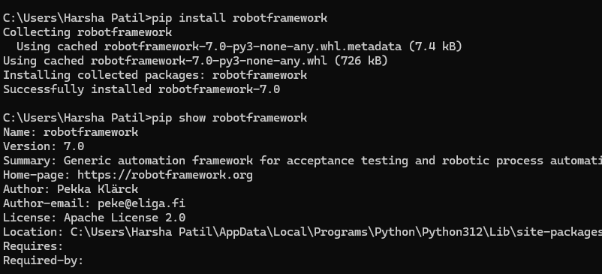
Installation of Selenium/ Robot Fw
Command to install selenium
cmd> pip install selenium
Command to install Robot framework
cmd> pip install robotframework
cmd> pip show selenium
cmd > pip show robotframework

Slide 14
Installation of Selenium/Robot Framework
Other commands
pip install –-upgrade robotframework
pip install robotframework == 2.9.0
pip uninstall robotframework
pip list
pip show robotframework
Pip check robotframework

Slide 15
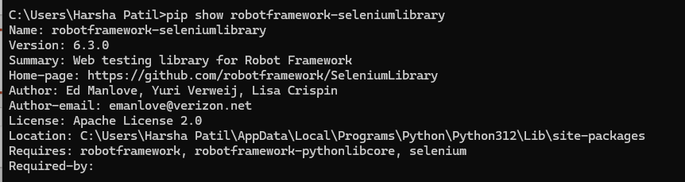
Installation of Robot framework selenium library

Slide 16
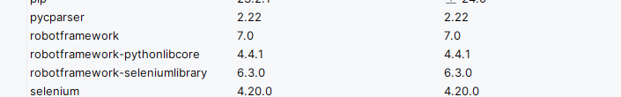
Installation of Robot framework / selenium library in pycharm
In pycharm goto – project -> setting -> project -> project interpreter-> click on + icon add the libraries

Slide 17
Installation of Robot framework / selenium library in Pycharm
In pycharm goto – project -> setting -> project -> project interpreter-> click on + icon add the libraries

Slide 18
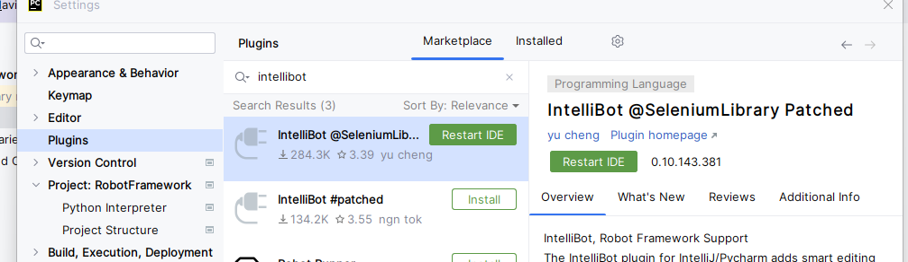
Installation of Intellibot plugin

Slide 19
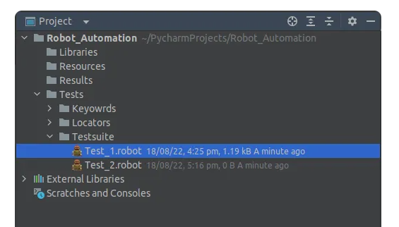
Test suites in Robot Framework

Slide 20
Testcases in Robot Framework
Robot Framework test scripts are text files with the *.robot or *.txt extensions. The four sections of basic Robot test scripts are setting, variables, keywords, and test cases.
SETTINGS
The settings section contains the import statements for the external libraries, resources, and the setup and teardown commands.
VARIABLES
The variables section contains keyword arguments, global, and local values. Variables make it easy to change the test data in one location.
KEYWORDS
The keywords section contains operations used to execute the tests. The different types of keywords are built-in keywords, library keywords, and user-defined keywords. Built-in and library keywords are lower-level keywords defined by the built-in Robot Framework library or an external library such as Selenium. User-defined keywords are keywords created by combining library keywords.
TEST CASES
The test cases section contains the test cases. Two of the more common approaches to writing test cases are keyword-driven and Gherkin.

Slide 21
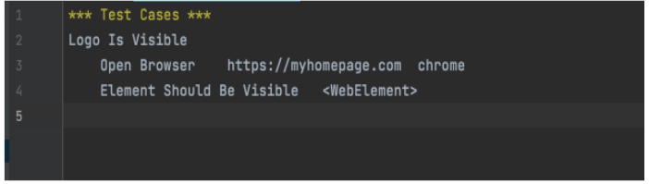
Testcases in Robot Framework
Keyword-driven Approach
The keyword-driven approach uses the Robot Framework built-in keywords and keywords from an external library like Selenium.

Slide 22
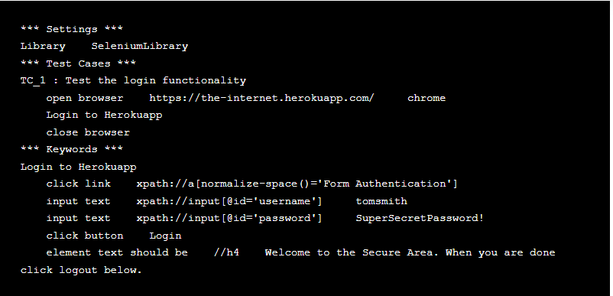
Testcases in Robot Framework

Slide 23
Keywords and Test libraries
Understanding Keywords
In Robot Framework, keywords are the fundamental building blocks of test cases. Keywords represent actions, verifications, or operations that you want to perform during your tests. There are three primary types of keywords:
Built-In Keywords: These keywords come prepackaged with Robot Framework and cover a wide range of common actions and verifications. They are part of the Robot Framework core and are readily available for use.
User-Defined Keywords: Testers can create their own custom keywords to encapsulate and reuse sequences of actions or verifications. User-defined keywords enhance test case modularity and maintainability.
External Keywords: External keywords are provided by libraries or external resources. Robot Framework supports integration with various libraries, such as SeleniumLibrary for web testing or DatabaseLibrary for database interactions. These libraries extend Robot Framework’s capabilities

Slide 24
Keywords and Test libraries
Using Built-In Keywords
Built-in keywords are readily available for use in Robot Framework, making it easy to perform common actions and verifications without writing custom code. These keywords are grouped into libraries based on their functionality. Here are some examples of commonly used built-in keywords:
Open Browser: Opens a web browser.
Input Text: Types text into a text field.
Click Button: Clicks a button on a web page.
Page Should Contain: Verifies that a web page contains specific text or elements.
Should Be Equal As Strings: Compares two strings for equality.

Slide 25
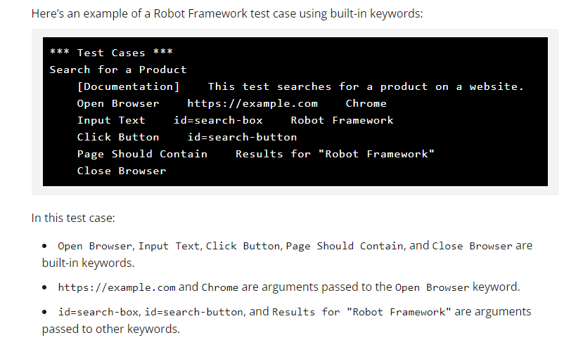
Built in Keywords

Slide 26
Custom Keywords
Creating Custom Keywords
While built-in keywords cover a wide range of actions, there will be situations where you need to create custom keywords to encapsulate specific test steps or verifications.
Creating custom keywords is a powerful feature of Robot Framework that enhances the maintainability and reusability of your test cases.

Slide 27
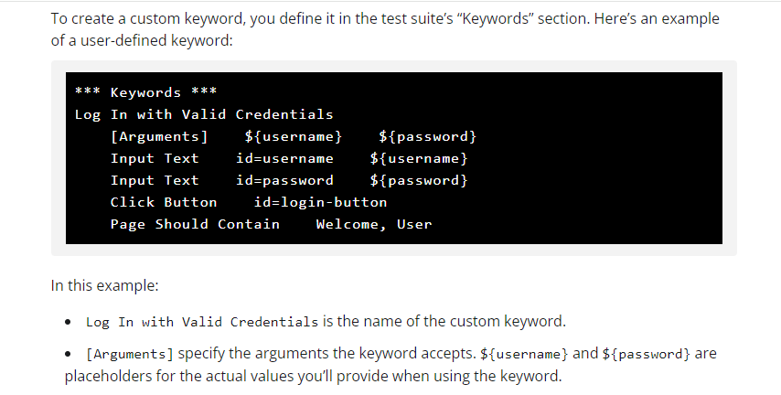
Custom Keywords

Slide 28
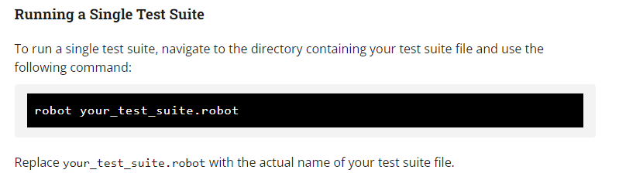
Test execution in Robot Framework

Slide 29
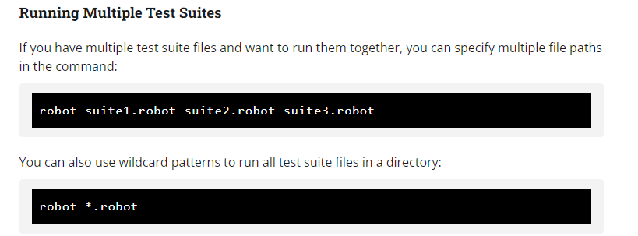
Test execution in Robot Framework

Slide 30
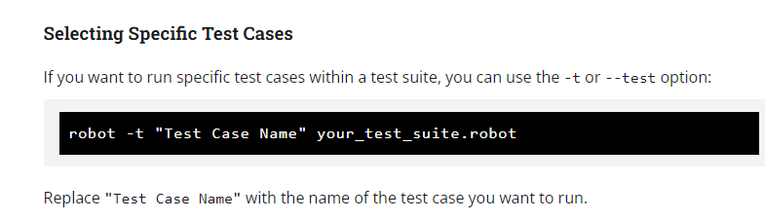
Test execution in Robot Framework

Slide 31
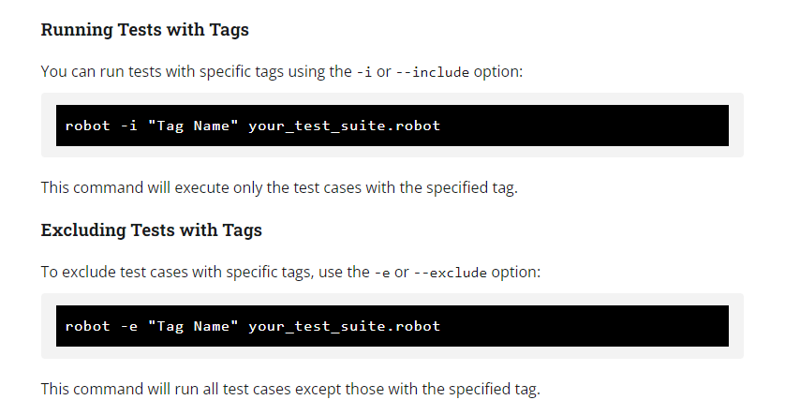
Test execution in Robot Framework

Slide 32
Test execution in Robot Framework
Interpreting Test Execution Results
Once you’ve executed your test cases, Robot Framework generates detailed test execution reports. These reports are available in various formats, including HTML, XML, and plain text. The most commonly used format is HTML, as it provides a user-friendly and visual representation of the test results.
HTML Report
After running your tests, you can find the HTML report in the output directory (by default, the “output” directory in your project folder). Open the HTML report in a web browser to view the results.

Slide 33
Test execution in Robot Framework
The HTML report provides a summary of the test execution, including:
Number of test cases executed.
Number of test cases passed, failed, and skipped.
Execution time for each test case and the entire suite.
Detailed logs for each test case, including keyword execution and messages.
A visual representation of test case status (pass or fail).

Slide 34
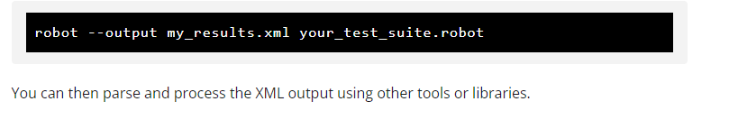
Test execution in Robot Framework
XML and Other Formats
Robot Framework also generates test execution results in XML, plain text, and other formats. These formats are useful for integration with CI/CD pipelines and test management systems. You can specify the output format using the --output option when running tests:

Slide 35
Test execution in Robot Framework
XML and Other Formats
Robot Framework also generates test execution results in XML, plain text, and other formats.
These formats are useful for integration with CI/CD pipelines and test management systems.
You can specify the output format using the --output option when running tests:

Slide 36
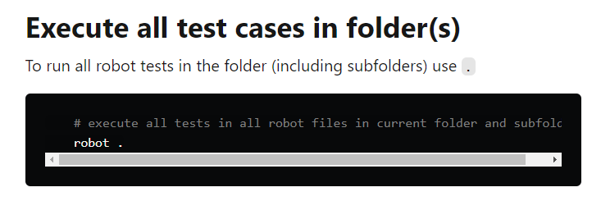
Command Line arguments

Slide 37
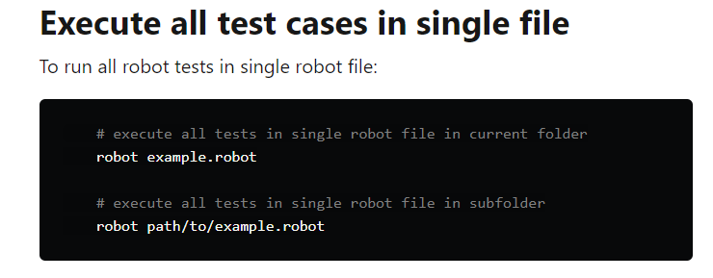
Command Line arguments
https://dev.to/juperala/how-to-run-robot-framework-test-from-command-line-5aa

Slide 38
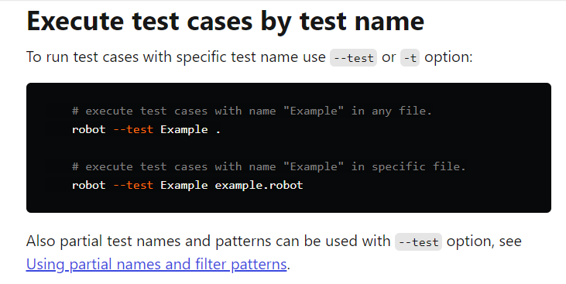
Command Line arguments

Slide 39
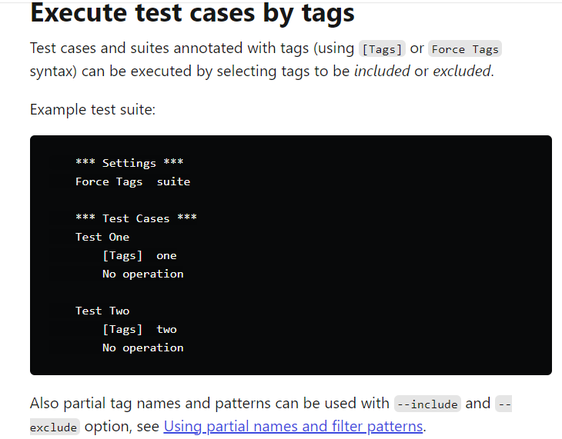
Command Line arguments

Slide 40
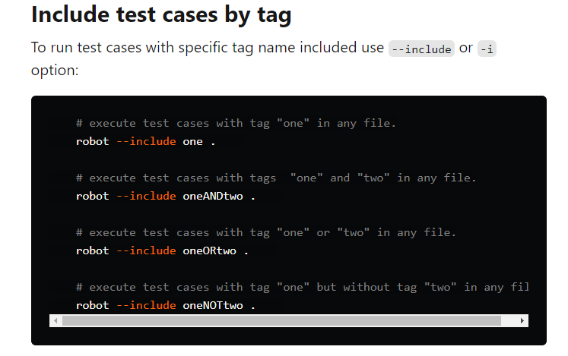
Command Line arguments

Slide 41
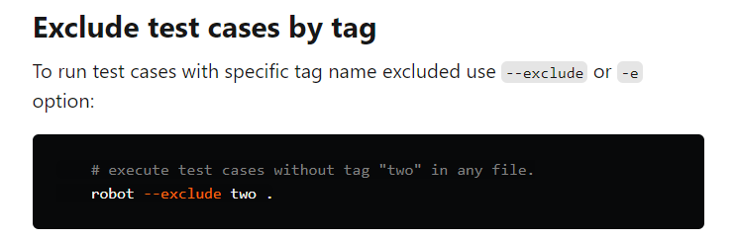
Command Line arguments

Slide 42
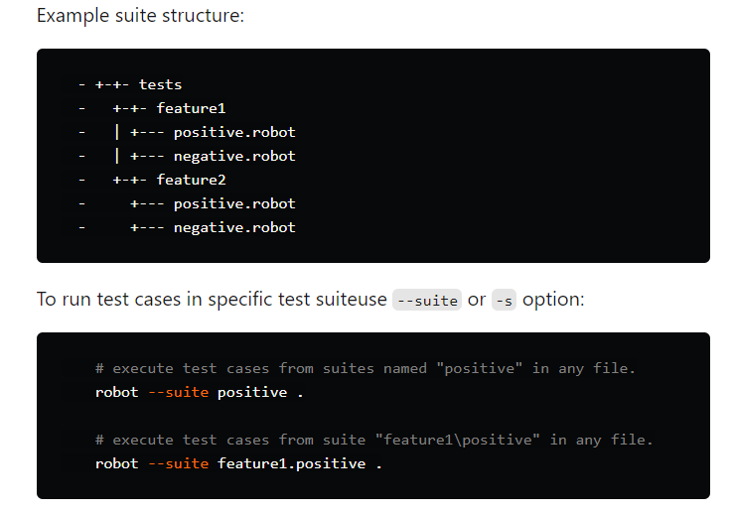
Command Line arguments

Slide 43
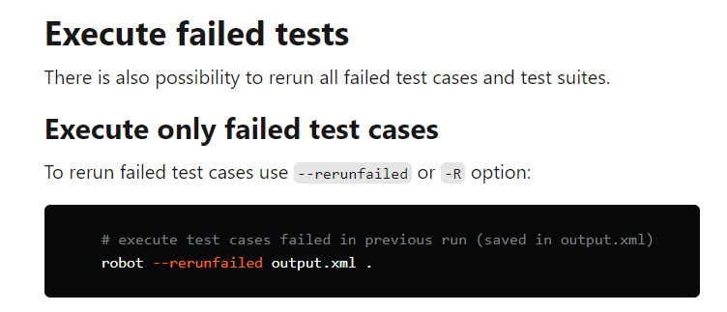
Command Line arguments

Slide 44
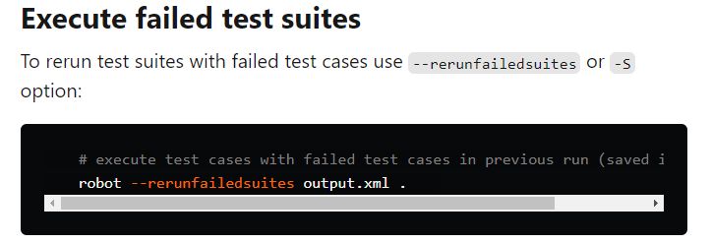
Command Line arguments

Slide 45
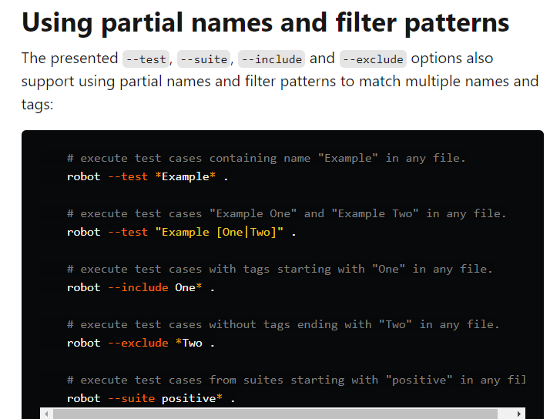
Command Line arguments

Slide 46
External libraries
What Are External Libraries?
External libraries in Robot Framework are Python-based modules or packages that extend the framework’s functionality beyond what’s available in its standard libraries.
These external libraries are developed by the community, organizations, or individuals and can address specific automation and testing needs.
They provide custom keywords, utility functions, and integrations that seamlessly integrate with Robot Framework.

Slide 47
External libraries
External libraries come in various types, each designed to fulfill specific automation and testing needs. Here are some common types of external libraries used in Robot Framework:
Testing Libraries: These libraries provide functionality for specific types of testing, such as web testing (e.g., SeleniumLibrary), REST API testing (e.g., RequestsLibrary), or database testing (e.g., DatabaseLibrary).
Custom Libraries: You can create custom external libraries to encapsulate project-specific functionality or interact with internal systems and tools.
Utility Libraries: These libraries offer utility functions and keywords to simplify common automation tasks, such as working with files, dates, or strings.
Reporting Libraries: Reporting libraries allow you to customize the format and content of your test reports and logs, tailoring them to your project’s specific needs.

Slide 48
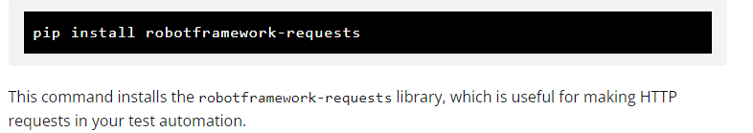
External libraries
Integrating External Libraries
Integrating external libraries into your Robot Framework test suites is a straightforward process. Here are the general steps to follow:
1. Install the External Library
Before using an external library, you need to install it. You can typically install external libraries using Python’s package manager, pip. For example:

Slide 49
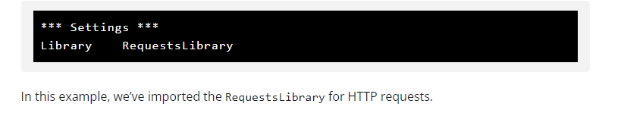
External libraries
2. Import the External Library
In your Robot Framework test suite, you import the external library using the Library setting. Specify the name of the library or the path to the library file, depending on the library’s requirements.

Slide 50
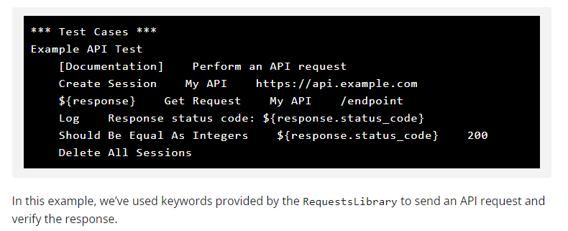
External libraries
3. Use External Library Keywords
Once the library is imported, you can use its keywords in your test cases just like built-in Robot Framework keywords.
You can invoke custom keywords provided by the external library to perform specific actions or verifications in your automation tasks.

Slide 51
Data Driven testing
https://docs.robotframework.org/docs/testcase_styles/datadriven
What is Data-Driven Testing?
Data-Driven Testing is a test design and execution method where the test scripts read data from sources such as XLS, XML, and CSV files rather than utilizing hard-coded values.
This strategy allows the automation engineers to implement a single test script that can execute tests for all the test data in the table.

Slide 52
Data Driven testing
Test Cases can be written in a data-driven style where test cases use only one higher-level keyword, that hides the actual test workflow.
These tests are very useful when there is a need to test the same scenario with different input and/or output data.
The Test Template setting defines the Keyword which is executed for every test case.
The Test Cases section just contains
the Test Case Name
the arguments for the Keyword defined in the Test Template setting

Slide 53
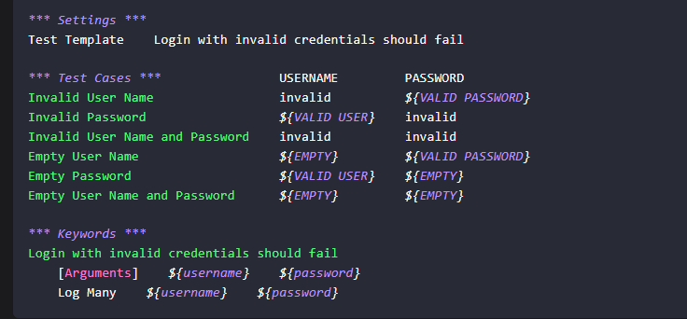
Data Driven testing

Slide 54
Data Driven testing
Using DataDriver Library
The DataDriver library is an extension for Robot Framework®.
DataDriver creates new test cases based on a Data-File that contains the data for Data-Driven Testing. These data file may be .csv , .xls or .xlsx files.
The DataDriver library is not included in the Robot Framework distribution, but it can be installed using pip.
pip install robotframework-datadriver

Slide 55
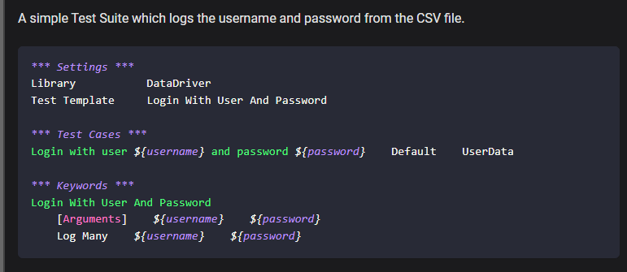
Data Driven testing

Slide 56
Web Testing with SeleniumLibrary
SeleniumLibrary is a web testing library for Robot Framework that utilizes the Selenium tool internally. The project is hosted on GitHub and downloads can be found from PyPI.
See Keyword Documentation for available keywords and more information about the library in general.
Installation instructions
pip install --upgrade robotframework-seleniumlibrary
Afterwards you can import the library into your test case or resource file.

Slide 57
Benefits of SeleniumLibrary in Robot Framework
Cross-Browser Compatibility: SeleniumLibrary supports multiple web browsers, allowing you to test web applications across different browser types.
Extensive Documentation: SeleniumLibrary provides comprehensive documentation and examples, making it accessible for both beginners and experienced testers.
Community Support: Selenium has a large and active community, which means you can find support, tutorials, and plugins to extend its functionality.
Integration with Other Libraries: SeleniumLibrary can be integrated with other Robot Framework libraries for broader testing capabilities, such as database testing or REST API testing.
Parallel Testing: SeleniumLibrary supports parallel test execution, which can significantly reduce test execution time for large test suites.
Robust Reporting: Robot Framework’s reporting capabilities, combined with SeleniumLibrary, provide detailed logs and reports for test execution, helping you identify and diagnose issues quickly.

Slide 58
What is Automation ?
Automation testing is a Software testing technique to test and compare the actual outcome with the expected outcome.
This can be achieved by writing test scripts or using any automation testing tool. Test automation is used to automate repetitive tasks and other testing tasks which are difficult to perform manually.
Automated testing is most preferable for large projects that require testing the same areas over and over
The test automation performs testing at three different levels:
  Unit Level Automation
    Nunit
    Junit
    TestNg
  API Testing
    Rest Assured
    Katalon
  User Interface
    Selenium
    Cypress
    Playwright

Slide 59
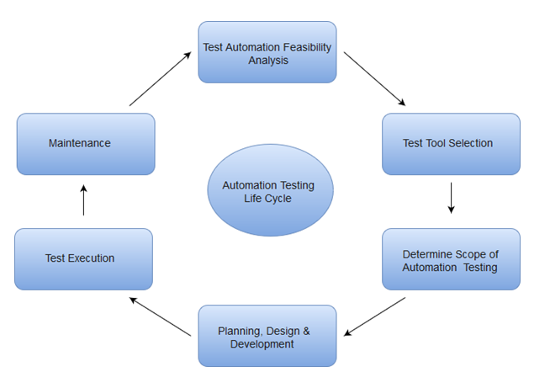
Automation Testing life cycle

Slide 60
Why Automation Testing?
Some of the reasons why Automation Testing is important:
Running Tests 24/7: You can start the test from anywhere in the world and anytime you want to. You can even do that remotely if you don’t have a lot of devices or you don’t have the possibility to buy them.
Fewer Human Resources: You just need a test automation engineer to write your scripts to automate your tests, instead of a lot of people doing boring manual tests over and over again.
Reusability: The scripts are reusable and you don’t need new scripts every time. Also, you can redo the steps that are exactly as the previous ones.
Bugs: Automation helps you find bugs in the early stages of software development, reducing expenses and working hours to fix these problems as well.
Reliability: Automated testing is more reliable and way quicker when running boring repetitive standardized tests which can not be skipped, but may cause errors when manually tested.

Slide 61
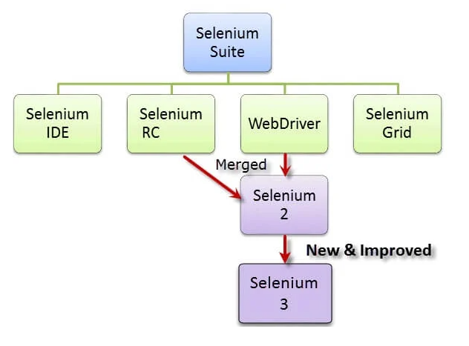
What is Selenium and Tools ?
Selenium is a free (open-source) automated testing framework used to validate web applications across different browsers and platforms.
You can use multiple programming languages like Java, C#, Python, etc to create Selenium Test Scripts. Testing done using the Selenium testing tool is usually referred to as Selenium Testing.
Only testing web applications is possible with Selenium. You cannot use it to test desktop applications or mobile applications.
Selenium Tools
  Selenium Integrated Development Environment (IDE)
  Selenium Remote Control (RC)
  Selenium WebDriver
  Selenium Grid

Slide 62
Who developed Selenium?
Since Selenium is a collection of different tools, it had different developers as well. Below are the key persons who made notable contributions to the Selenium Project Primarily, Selenium was created by Jason Huggins in 2004

Slide 63
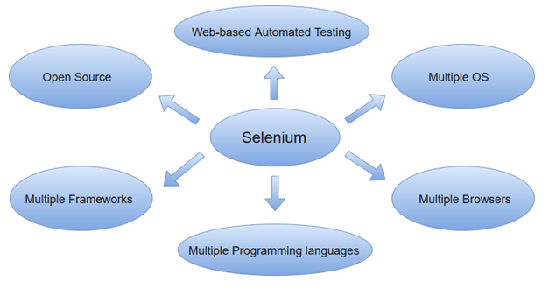
Why Selenium?
Open Source Availability
Widely used in Industry
Multi-Browser Support
Support for programming languages and framework
Support Across Various Operating Systems
Ease Of Implementation
Reusability and Integrations
Parallel Test Execution
Less Hardware Usage
Constant Updates and Good Community Support

Slide 64
Disadvantages of Selenium
Selenium can test only web applications. It cannot test software applications and other desktop applications.
Selenium cannot access the web elements outside the web applications that are under test.
No guaranteed user support is available. We have to depend on customer communities.
Selenium independently does not support image testing. It must be integrated with Sikuli for image testing.
Captcha testing is not [possible using selenium
OTP testing is not possible using selenium

Slide 65
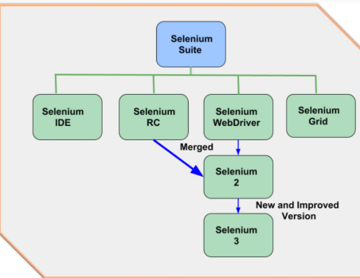
Versions of selenium

Slide 66
ELEMENT LOCATORS
Locators are nothing but the identifications of the elements in application.
Since every product in the world is having some identifications, in the same way every element in the application also having some identifications.
These identifications we called as “locators” or “Properties and Values” or “Attributes”

Slide 67
ELEMENT LOCATORS
1. ID
2. Name
3. Class
4. Tagname
5. Xpath
6. Link text
7. CSS (Cascade style sheets)
8. Partial link text

Slide 68
Xpath
XPath is defined as XML Path
XPath is unique locator of the element in application
Xpath is a syntax or language for finding any element on the web page using XML path expression
Xpath is used to find out the location of element on a webpage using HTML DOM Structure.

Slide 69
Types of XPath
There are two types of XPath:
Absolute XPath
Relative XPath

Slide 70
Types of XPath
Absolute XPath
Identify the exact location of the element in HTML page from html tag to till the element.
It begins with forward slash (/), which means you can select the element from the root node
Below is the example of Absolute Xpath expression of the element.
Ex. /html/body/div[1]/div[2]/div[1]/div/div/div/div[2]/div/div[1]/form/div[1]/div[1]

Slide 71
Types of XPath
Relative XPath
Relative XPath find out the element based on the unique locators
For Relative Xpath path starts from the middle of the HTML DOM Structure
It start with double forward slash (//) which means it can search the element anywhere at the webpage.
Below is the example of Relative Xpath expression of the element.
Syntax: //Tagname[@locator=‘value’]
Ex: //input[@name=‘username’]

Slide 72
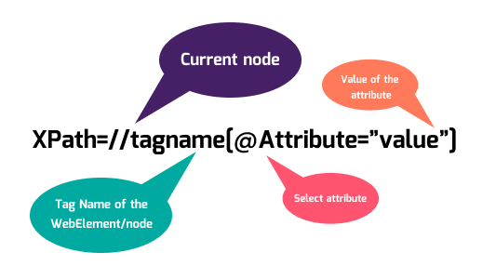
Types of XPath

Slide 73
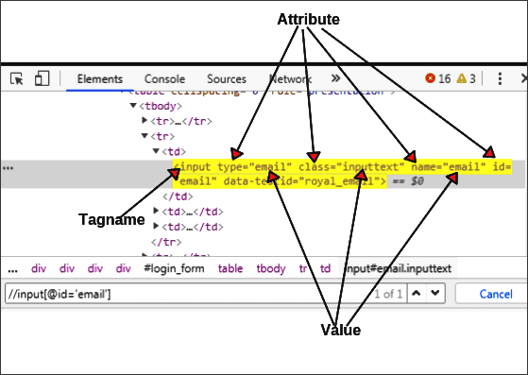
Types of XPath

Slide 74
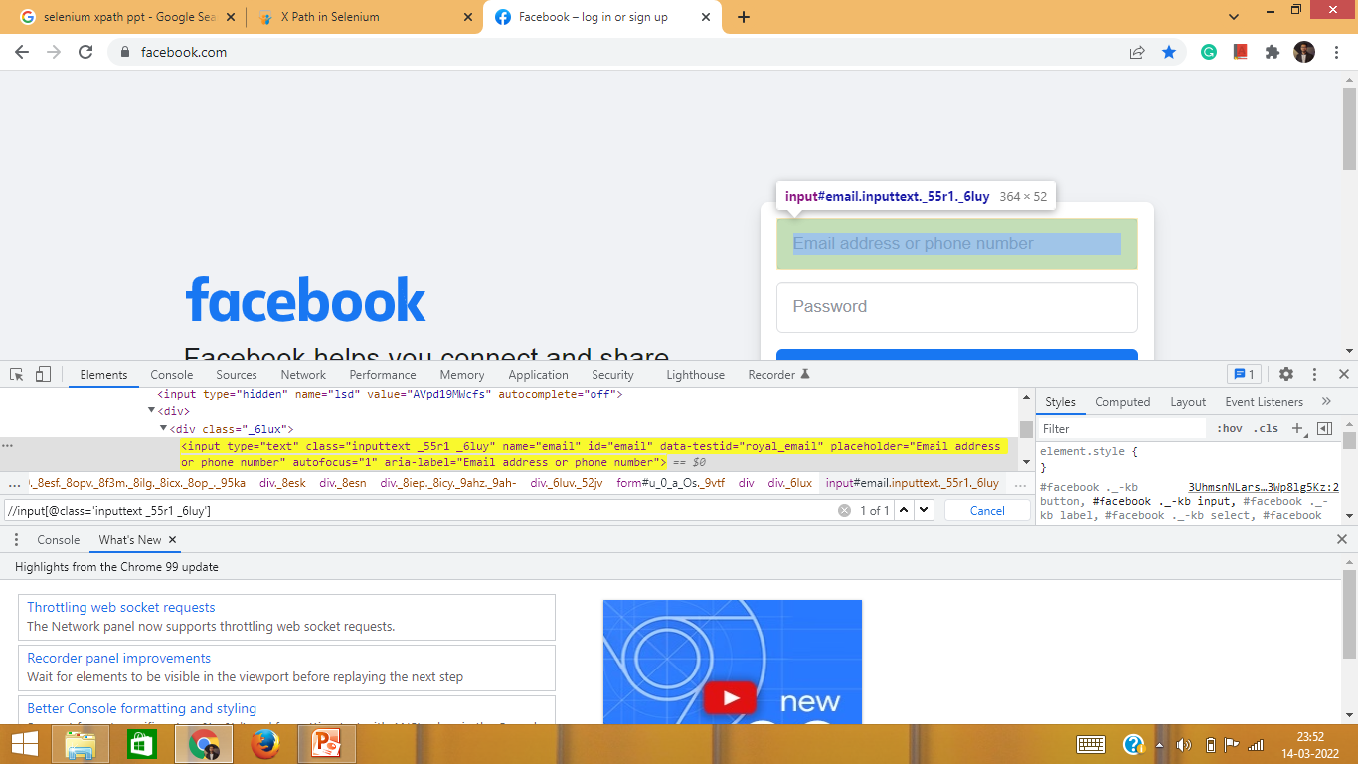
Types of XPath

Slide 75
Types of XPath
Absolute XPath | Relative XPath
Identify the exact location of the element in HTML page from html tag to till the element. | Relative XPath find out the element based on the unique locators
It begins with forward slash (/) | It start with double forward slash (//)
Not preferable in real time project. | Always preferable in real time project.
Example: /html/body/div[1]/div[2]/div[1]/div/div/div/div[2]/div/div[1]/form/div[1]/div[1] | Example: //input[@name=‘username’]

Slide 76
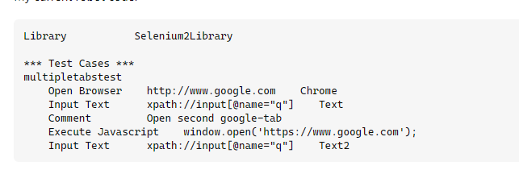
Launching of Browsers

Slide 77
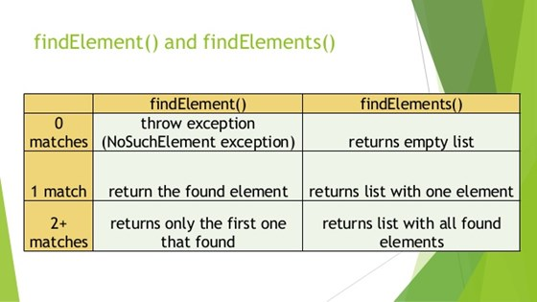
Find element and elements

Slide 78
Implicit Waits in Robot Framework
Implicit waits are applicable to all the elements in a web page at a global level.
Set Selenium Implicit Wait: Sets the Implicit wait value used by selenium.
This keyword sets the implicit wait for all opened browsers. By applying implicit wait, we can ask the web driver to wait for a specific amount of time before it throws an exception.
Get Selenium Implicit Wait: Gets the Implicit wait value used by selenium.
This keyword will return the value of the implicit wait time. The value is returned as a human-readable string, e.g., 1 second.
Set Browser Implicit Wait: Sets the implicit wait value used by Selenium.
Same as Set Selenium Implicit Wait but only affects the current browser.

Slide 79
Explicit Waits in Robot Framework
Explicit waits are specifically applied to an element intended by us, instead of all the elements of the web page. It is most useful when we get certain elements on a webpage that need a longer time to load.
Keywords that are provided by the robot framework to apply explicit waits are:
Wait Until Page Contains – Waits until text appears on the current page
Wait Until Page Contains Element – Waits until the element locator appears on the current page
Wait Until Page Does Not Contain – Waits until the text disappears from the current page
Wait Until Page Does Not Contain Element – Waits until the element locator disappears from the current page
Wait Until Location Is – Waits until the current URL is expected
Wait Until Location Is Not – Waits until the current URL is not location
Wait Until Location Contains – Waits until the current URL contains expected
Wait Until Location Does Not Contain – Waits until the current URL does not contain the location
Wait Until Element Contains – Waits until the element locator contains text
Wait Until Element Does Not Contain – Waits until the element locator does not contain text
Wait Until Element Is Enabled – Waits until the element locator is enabled
Wait Until Element Is Not Visible – Waits until the element locator is not visible
Wait Until Element Is Visible – Waits until the element locator is visible

Slide 80
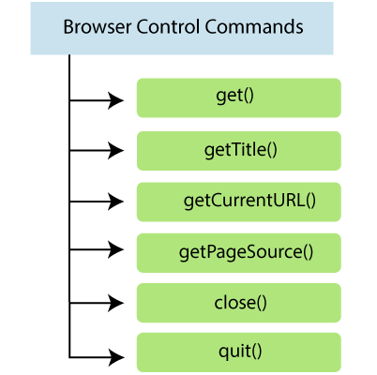
Browser Commands

Slide 81
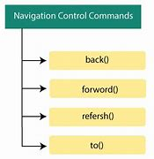
Navigational Commands

Slide 82
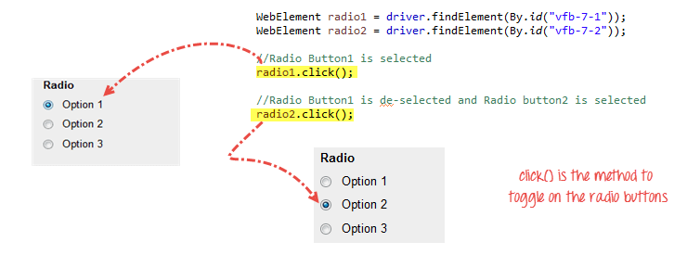
Handle Radio buttons / check boxes

Slide 83
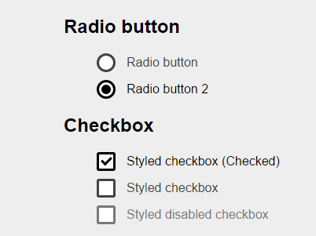
Handle Check boxes buttons

Slide 84
Validation commands in selenium

Slide 85
Alerts in Selenium
Alerts are small popup boxes/windows which display the messages/notifications and notify the user with some information seeking some permission on certain kinds of operations
Additionally, we can also use them for warning purposes. Sometimes, the user can enter a few details in the alert box as well
For Example, The alert box displayed below requires an action from the user to press OK and accept or press Cancel and dismiss the message box
Application alerts shift your focus from the current browser window to a newly opened window and force the user to read the message displayed and act accordingly
Users will be blocked and will not be able to work further unless the alert message box gets handled

Slide 86
Handling Alerts in Selenium
accept() : This method clicks on the 'OK' button of the alert box
dismiss() : We use this method when the 'Cancel' button clicks in the alert box
sendKeys(String string): This method sends data to the alert box
getText() : This method captures the message from the alert box

Slide 87
Handling Prompt Alerts in Selenium
Need to switch to the alert first
Get the text from the alert using prompt.getText()
Enter the required text using sendKeys() method
And finally accept the alert to complete the alert test

Slide 88
Handling Confirmation Alerts in Selenium
Need to switch to the alert first
Get the text from the alert using prompt.getText()
And finally accept or dismiss the alert to complete the alert test

Slide 89
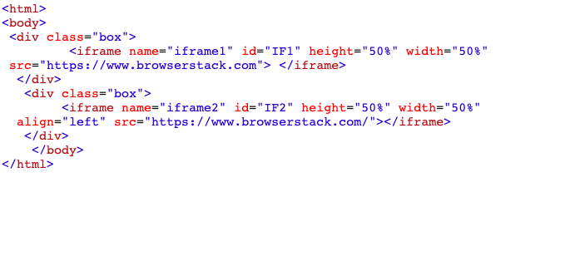
Frames
An iframe is also known as the inline frame. It is a tag used in HTML5 to embed an HTML document within a parent HTML document. An iframe tag is defined using <iframe></iframe> tags
The iframes are mainly used to insert content from external sources. For example, an advertisement displayed on a web page. They can float within the webpage, which means one can position an iframe at a specific position on a web page

Slide 90
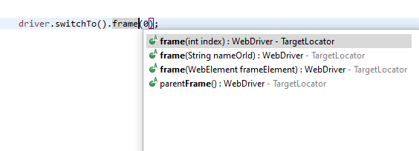
Frames
For a browser to work with several elements in iframes, it is crucial for the browser to identify all the iframes
we need to use the SwitchTo().frame method. This method enables the browser to switch between multiple frames

Slide 91

Web Table in Selenium
Typical example of Web Table

Slide 92

Web Table in Selenium
Get number of rows of a web table in Selenium
Get number of columns of a web table in Selenium

Slide 93

Web Table in Selenium
Fetch data from a specific table cell

Slide 94
Dynamic Web Table in Selenium
There is no rocket science in the handling of tables. All you need to is to inspect the table cell and get the HTML location of it
All we need to find the exact position / location of the specific cell of which we want to fetch the data.

Slide 95

Reading text from Webpage
We can get the text from a website using Selenium webDriver USING the getText() method. It helps to obtain the text for a particular element which is visible
First of all, we have to identify the element on the page for which we want to get the text with the help of any locators like id, class, name, xpath, cssSelector, tag name, link text or partial link text

Slide 96

Reading text from Webpage
We can also get the entire text of a webpage using getText() method

Slide 97
Alerts in Selenium
Alerts are small popup boxes/windows which display the messages/notifications and notify the user with some information seeking some permission on certain kinds of operations
Additionally, we can also use them for warning purposes. Sometimes, the user can enter a few details in the alert box as well
For Example, The alert box displayed below requires an action from the user to press OK and accept or press Cancel and dismiss the message box
Application alerts shift your focus from the current browser window to a newly opened window and force the user to read the message displayed and act accordingly
Users will be blocked and will not be able to work further unless the alert message box gets handled

Slide 98

Simple Alert
These alerts are just informational alerts and have an OK button on them. Users can click on the OK button after reading the message displayed on the alert box
A simple alert box looks like below

Slide 99

Prompt Alert
In Prompt alerts, some input requirement is there from the user in the form of text needs to enter in the alert box
A prompt alert box is displayed like below, where the user can enter his/her username and press the OK button or Cancel the alert box without entering any details

Slide 100

Confirmation Alert
These alerts get some confirmation from the user in the form of accepting or dismissing the message box
They are different from prompt alerts in a way that the user cannot enter anything as there is no text-box available
Users can only read the message and provide the inputs by pressing the OK/Cancel button

Slide 101

Handling Alerts in Selenium
Alert.accept()
Alert.dismiss()
Alert.getText()
Alert.sendKeys(String str)

Slide 102

Handling Alerts in Selenium
accept() : This method clicks on the 'OK' button of the alert box
dismiss() : We use this method when the 'Cancel' button clicks in the alert box
sendKeys(String string): This method sends data to the alert box
getText() : This method captures the message from the alert box

Slide 103

Handling Prompt Alerts in Selenium
Need to switch to the alert first
Get the text from the alert using prompt.getText()
Enter the required text using sendKeys() method
And finally accept the alert to complete the alert test

Slide 104

Handling Confirmation Alerts in Selenium
Need to switch to the alert first
Get the text from the alert using prompt.getText()
And finally accept or dismiss the alert to complete the alert test

Slide 105
Frames
An iframe is also known as the inline frame. It is a tag used in HTML5 to embed an HTML document within a parent HTML document. An iframe tag is defined using <iframe></iframe> tags
The iframes are mainly used to insert content from external sources. For example, an advertisement displayed on a web page. They can float within the webpage, which means one can position an iframe at a specific position on a web page

Slide 106
Handling Frames in Selenium
For a browser to work with several elements in iframes, it is crucial for the browser to identify all the iframes
we need to use the SwitchTo().frame method. This method enables the browser to switch between multiple frames
Driver.switchTo().frame(int)
Driver.switchTo().frame(String)
Driver.switchTo().frame(WE)
Driver.switchTo().parentFrame()

Slide 107

Finding Total No Of Frames
We can find no of frames on webpage using JavascriptExecutor

Slide 108

Switching between Frames
switchTo.frame(int index)
switchTo.frame(String frameName)
switchTo.frame(Webelement iframeElement)

Slide 109

Action Class
Actions class is an ability provided by Selenium for handling keyboard and mouse events
Operations like drag and drop, clicking on multiple elements with the control key
Typical syntax of Actions class is as follows:

Slide 110
Action Class
Mouse Actions in Selenium
doubleClick(): Performs double click on the element
clickAndHold(): Performs long click on the mouse without releasing it
dragAndDrop(): Drags the element from one point and drops to another
moveToElement(): Shifts the mouse pointer to the center of the element
contextClick(): Performs right-click on the mouse

Slide 111
Action Class
Keyboard Actions in Selenium
sendKeys(): Sends a series of keys to the element
keyUp(): Performs key release
keyDown(): Performs keypress without release

Slide 112

Double Click Action
First find the element on which double click has to be performed
Use Action class’s doubleClick(Webelement).perform(),

Slide 113

Click and Hold Action
First move the mouse pointer to expected element
Use Action class’s clickAndHold(Webelement).perform()

Slide 114

Drag And Drop Action
Find Draggable element i.e. From element
Find droppable element i.e. to element
Use Action class’s dragAndDrop(fromWebelement, toWeElement).perform()

Slide 115

ContextClick Action
Context click is nothing but right click mouse action
Find the element on which context click (right click() has to be performed
Use Action class’s contextClick(Webelement).perform()

Slide 116

sendKeys, keyUp and keyDown Action
Actions class sendkeys are typically used for copy and paste text on webpage
In the following code snippet, text from the text field is copied and then pasted in another text field

Slide 117

JavascriptExecutor
JavascriptExecutor is an interface that is used to execute JavaScript with Selenium
JavaScript is a programming language that interacts with HTML in a browser, and to use this function in Selenium, JavascriptExecutor is required
executeScript(script, webElement)
executeAsyncScript(script, webElement)

Slide 118

How to scroll a Page
Using JavascriptExecutor, we can scroll to an element till its visible
Need to find that webelement first and then use scrollIntoView() javascript

Slide 119

How to scroll a Page
The scrollBy() javascript method involves two parameters, x, and y, that represent the horizontal and vertical pixel values, respectively
User can give x and y co-ordinates value as Zero, positive and negative to adjust where to scroll

Slide 120

Capture Screenshot
In order to capture a screenshot in Selenium, one has to utilize the method TakesScreenshot. This notifies WebDriver that it should take a screenshot in Selenium and store it
Screenshots are often helpful in case of debugging where and what failure is happened while execution

Slide 121
API testing using Robot Framework
We will be using 5 libraries for our tests. They are:
1. SeleniumLibrary which is already installed.
2. RequestsLibrary – Install it using pip3 install robotframework-requests.
3. JSONLibrary – Install it using pip3 install robotframework-jsonlibrary.
4. Collections – This comes inbuilt with robot Framework. We just need to import it.
5. BuiltIn – Robot Framework’s standard library that provides a set of generic keywords. No need to import as it is always available.

Slide 122
API testing using Robot Framework
Test – 1
Step 1: Perform a ‘GET’ request to https://www.metaweather.com/api/location/search/?query=london
Step 2: Verify that the response code is ‘200’.
Step 3: Verify that the ‘title’ key in the response body has the value ‘London’.
Step 4: Verify that the ‘location_type’ key is present in the response body.

Slide 123
API testing using Robot Framework
Test – 2
Step 1: Perform a ‘POST’ request to https://jsonplaceholder.typicode.com/posts with header and body.
Step 2: Verify that the response code is ‘201’.
Step 3: Verify that the ‘id’ key in the response body has the value ‘101’.
Step 4: Verify that the value of the response header ‘Content-Type’ is ‘application/json; charset=utf-8’.
https://testersdock.com/handle-javascript-alert-robot-framework/
https://github.com/juhitab/RobotFramework-Python-Selenium/blob/master/robotframework-selenium/testdata/ddtLogindataCSV.csv.txt

Slide 124
Thanks

